Slide 1

Computer System Servicing
The Class will start in a few minutes…..

Slide 2
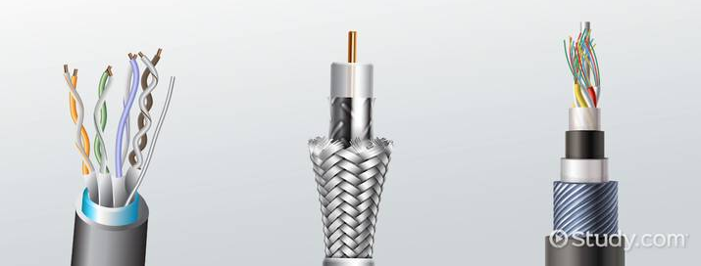
Network Cable
Are used to connect one network device to other network devices or to connect two or more computers to share printers, scanner etc..

Slide 3
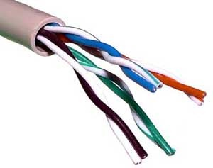
Types of Network Cable
UTP (Unshielded Twisted Pair)
A popular type of cable that is commonly used for Local Area Network. It has two unshielded wires twisted around each other.

Slide 4
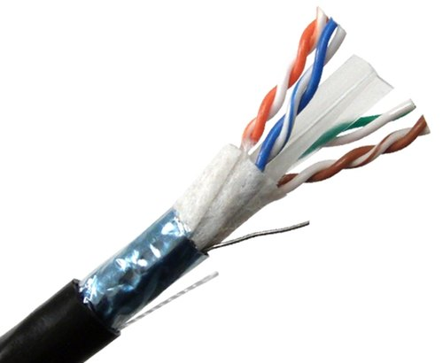
Types of Computer Network
2. STP (Shielded Twisted Pair)
The extra covering of the STP Cable provides protection to prevent electromagnetic interference

Slide 5
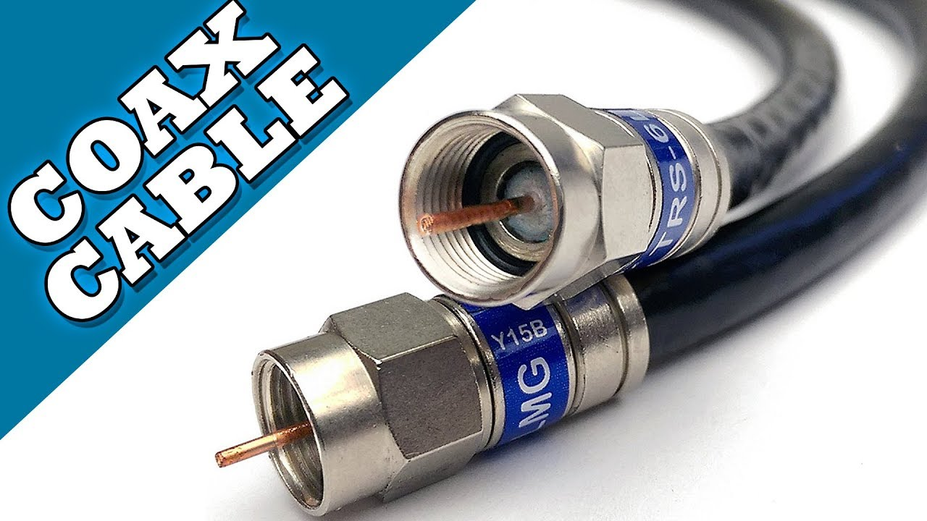
Types of Computer Network
3. Coaxial Cable
This cable commonly used in Television industries. The metal shield surrounding the cable helps block interference from fluorescence lights, motors, and other computers.

Slide 6
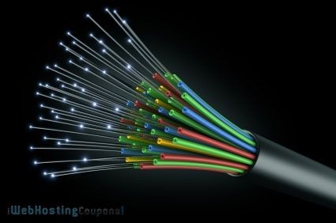
Types of Computer Network
4. Fiber Optics Cable
Transmits light rather than electronic signals which reduce the risk of electrical interference. It is ideal for environment where electrical interference is present.

Slide 7
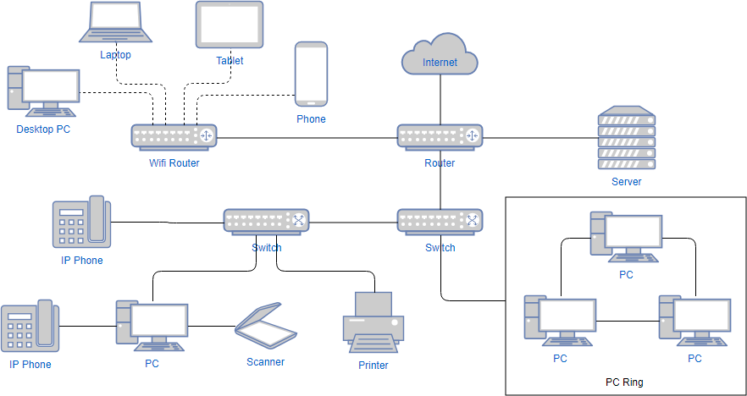
Network Architecture
Refers to the way network devices and services are designed to serve the connectivity needs of client devices

Slide 8
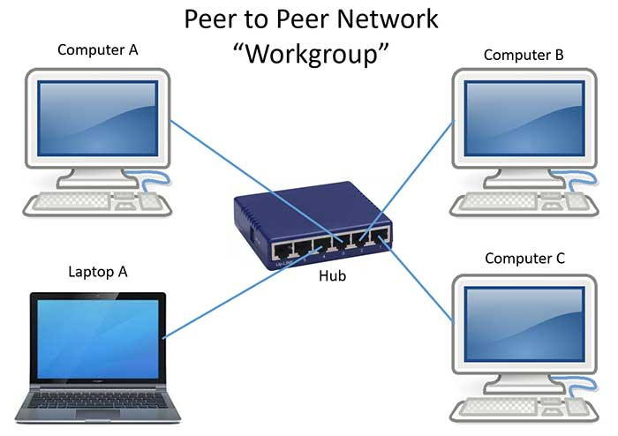
Network Architecture
1. Peer-to-peer Network
This consists of two or more computers share files and access to devices such as printer without requiring a server computer.

Slide 9
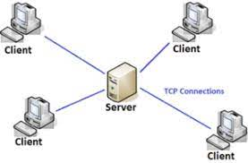
Network Architecture
2. Client/Server Network
A computer network in which one centralized, powerful computer(called the Server) is a hub to which many less powerful personal computers or workstations (called Client) are connected.

Slide 10
Advantages & Disadvantages of Peer-to-peer Network
ADVANTAGES | DISADVANTAGES
Use less expensive computer hardware | Not very Secure
Easy to Administer | No central point of storage or file archiving
Easy setup and Low cost | Additional load on computer because of resource sharing

Slide 11
Advantages & Disadvantages of Client/Server Network
ADVANTAGES | DISADVANTAGES
Very Secure | Require Professional Administration
Better Performance | More hardware intensive
Centralized Backup | More software intensive
Very Reliable | Expensive dedicated software

Slide 12
FORMATIVE ASSESSMENT
Direction: Differentiate P2P from Client/Server Network

Slide 13
Practical Application of the acquired
Learning Competencies

Slide 14

GENERALIZATION

Slide 15
THANK YOU!!!

